Slide 1
Subject: CIVIC EDUCATION
Term: FIRST TERM
Session : 2023/2024
Class : GRADE 9
Compiled by: MR. VITALIS
Educator: MR. IMI CLEMENT

Slide 2
SCHEME OF WORK
The Constitution – Meaning, types & differences
PRE-INDEPENDENCE CONSTITUTION
WEEK 2
WEEK 1:
INDEPENDENCE CONSTITUTION OF 1960
THE PRESIDENTIAL CONSTITUTION OF 1979
WEEK 4
WEEK 3:
WEEK 5:
RIGHT ATTITUDE TO WORK
NEGATIVE BEHAVIOR
WEEK 6
Mid Term Break
Security education, common crimes, Causes & effects
WEEK 8
WEEK 7:
WEEK 9:
NATIONAL SECURITY
Revision and Examination
WEEK 10

Slide 3
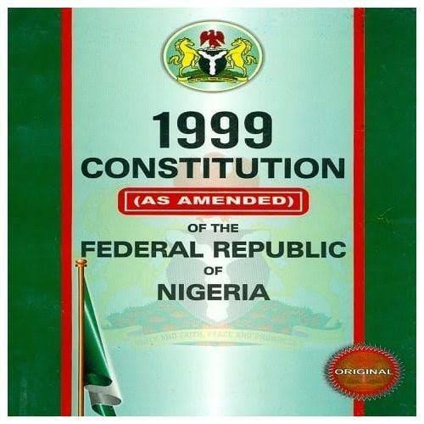
YR 9: WK 1
At the end of this topic, students should be able to;
1) Define a Constitution
2) Identify the various colonial Nigerian constitutions.
3) Identify features of colonial constitutions
4) Discuss features of colonial constitutions
WEEK ONE TOPIC:
THE
CONSTITUTION
Home page

Slide 4
INTRODUCTION
MEANING OF CONSTITUTION
Constitution is defined as a body of rules and regulations by which the citizens of a country are governed or ruled. A constitution also defines the powers and functions of the political office holders such as Presidents, Governors, Chairmen and Councilors of Local Government e.t.c. All the citizens in a country are expected to abide by the rules and regulations provided. The constitution also states the rights, duties and obligations of the citizens.

Slide 5
TYPES OF CONSTITUTION
WRITTEN CONSTITUTION:- it is a body of rules and regulations of a country that are written in a single document. Examples of country that operate written constitution are America, Nigeria, e.t.c
UNWRITTEN CONSTITUTION:- These are of body of rules and regulations of a country that are not contain in a single document. This type of constitution is usually based on the cultures, traditions, conventions and beliefs of the people. Britain is good example of country practicing unwritten constitution
RIGID CONSTITUTION:- Rigid constitution is defined as one that is very difficult to amend or change. Most written constitutions are rigid.

Slide 6
4. FLEXIBLE CONSTITUTION:- It is defined as the type of constitution that is easy to amend. Most unwritten constitutions are flexible. Britain, Italy e.t.c have unwritten and flexible constitution.
5. FEDERAL CONSTITUTION:- this is the type of constitution that divides the powers of government between the central, state and local government. Nigeria and America are good examples of countries that operate a federal constitution.
6. UNITARY CONSTITUTION:- A unitary constitution is one in which there is only one central government. State and local governments do not exist in a unitary constitution. Britain, Italy and France are good examples of country with unitary constitution.

Slide 7
SOURCES OF CONSTITUTION
The following are some of the sources of constitution:
1) The History of the people: The past political events and activities of the people in a country from part of their history. Their constitution, therefore, can emanate from such past history or events.
2) Acts of Parliament: The laws passed by national assembly in past years could be used in framing a new constitution for Nigeria.
3) Decrees: Laws made by military government are known as decrees. Such decrees made by past military administrations in Nigeria have formed essential part of Nigerian constitutions. Among such are decrees on creation of states, local governments, political parties, revenue allocation, electoral laws etc.

Slide 8
4) Judicial writings of eminent lawyers and jurists: The judicial writings of renowned and respected legal luminaries in Nigeria have contributed immensely to the formation of Nigerian constitutions.
5) International Decisions: Some international decisions made by international organizations such as UN, AU, ECOWAS etc. indirectly influence our constitutions. Decision on human rights, child right, Labour laws and many other which Nigeria is expected to comply with at times affect the content of our constitutions.
6) Others are: Customs and conventions, past constitutional conferences, constitution of other countries etc…

Slide 9
FUNCTIONS OF CONSTITUTION
The following are some of the functions of a constitution. The constitution:
1) Helps in resolving conflicts: A constitution helps in resolving conflicts among the various arms of government and citizens of a country.
2) Explains functions of Arms of Government: The constitution specifies the functions of the Executive, Judiciary and Legislature. This prevents each of them from stepping beyond their boundary.
3) Dictates the type of party system: The constitution of a country shows the type of party system the country will be operating whether one party, two or multi party systems.

Slide 10
4) Protects Rights and Liberties of Citizens: The constitution contains the fundamental human rights of citizens. Citizens whose rights are infringed upon can use the constitution to fight
5) Acts as a National Symbol: The constitution as a document is one of the symbols of sovereignty and nationhood. It is as important as the national flag, coat-of-arms and many other national symbols.
6) Directs Government Affairs: The act of governance would be a tedious task without a constitution. The constitution provides the guidelines for proper and smooth running of a country or society.

Slide 11
7) Dictates how Government is changed Periodically: The constitution specifies the tenure of a particular administration. This helps in planning when the next election would be held to elect new leaders.
8) The constitution is indispensable in the administration of a state. Administration would not be smooth, fair and efficient in the absence of a constitution.

Slide 12
YR 9: WK 1
TOPIC: THE CONSTITUTION>> Evaluation
Question 1
Explain the meaning of constitution
Question 2
State five sources of the constitution
Question 3
State five functions of the constitution
Question 4
Why is the constitution supereme?
Question 5
State three types of the constitution.

Slide 13

Any Questions?

Slide 14
YR 9: WK 2
At the end of this topic, students should be able to;
1) State pre independence constitution of Nigeria
2) Identify the various colonial Nigerian constitutions.
3) Identify features of colonial constitutions
4) Discuss features of colonial constitutions
TOPIC:
PRE-INDEPENDENCE CONSTITUTION
Home page

Slide 15
INTRODUCTION
By pre-independence constitutions, we mean the various constitutions made by colonial governments before Nigerian Independence in 1960.
These constitution were:
1) The Clifford constitution 1922
2) The Richard constitution 1946
3) The Macpherson constitution 1951
4) Lyttleton constitution of 1954
THE CLIFFORD CONSTITUTION OF 1922
The Clifford constitution was named after Governor Hugh Clifford who was the representative of the Queen of England in Nigeria.

Slide 16
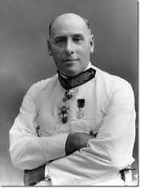
FEATURES OF CLIFFORD CONSTITUTION
1) There was an Executive council
Sir Hugh Clifford
2) It provided for a Legislative council
3) It provided for elective principle for the first time
4) It allowed formation of political parties e.g NNDP in 1923
ADVANTAGES OF CLIFFORD CONSTITUTION
1) It stimulated political activities

Slide 17
2) It allowed the establishment of political parties
3) It allowed elective representation where Nigerians were elected into legislature.
4) It established a central legislative council made up of 46 members for colony and Southern protectorate.
DISADVANTAGES
1) The executive had whites as members
2) No African representative in the executive council
3) It introduced elective principle which was for only Lagos and Calabar. The northerners were excluded from the council
4) The governor had both reserved and veto powers

Slide 18
5) The conditions attached to the elective principle were too difficult to fulfill
RICHARD CONSTITUTION OF 1946
This constitution was named after Sir Richard, though the groundwork for the constitution was done by Sir Bourdillon who retired as governor of Nigeria in 1944.
The constitution replaced the Clifford constitution of 1922. It was made specifically to promote the unity of Nigeria and to encourage Nigerians to participate in their own affairs.

Slide 19
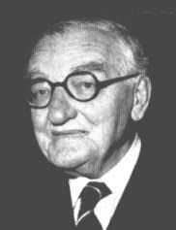
FEATURES OF RICHARD CONSTITUTION
1) The executive council was dominated by the Europeans.
2) It created Regional Houses of Assembly for the North, West and East.
Sir Arthur Richard
3) It created bi-cameral legislature for the North only.
4) Regional Assemblies were given limited power to legislate on minor matters
5) Nigerians were minority in the central Executive Council
6) It introduced regionalism: It created regions out of former protectorates.

Slide 20
7) It brought North and South together under one legislature
ADVANTAGES
1) It gives Nigerians more opportunities to have a say in their own affairs
2) It stimulated development of nationalist activities.
3) It brought South and North together under same legislature
4) It provided link between the native administration and the legislative council
5) It laid the foundation of federalism in Nigeria
6) It introduced regionalism in Nigeria

Slide 21
DISADVANTAGES
1) The Europeans still dominated the Executive council
2) It divided the country into unequal parts
3) The regional assemblies have limited areas of legislation
4) Governor still had veto power.
5) Nigerians were not involved in discussing the proposal
6) The number of Nigerians elected through elective principle was not increased
7) It made much provisions for unofficial majority in legislative council at the centre.

Slide 22
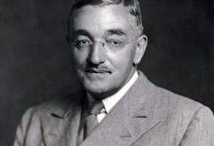
THE MACPHERSON CONSTITUTION OF 1951
The constitution was named after Sir John Macpherson who succeeded Sir Richard.
FEATURES
1) It created a central legislature
2) It created bi-cameral legislature for the West and the North
3) Each region had an executive council.
Sir. John Stuart Macpherson
4) Chief Commissioner for the three regions were renamed Lieutenant-Governors.
5) Africans were appointed into elective council as ministers (12 Nigerian ministers).

Slide 23
ADVANTAGES
1) It created, for the first time, the House of representatives
2) It provided bi-cameral legislature for both North and West
3) It made provision for greater autonomy to the regional houses to some extent.
4) Nigerians were part of the making of the constitution.
5) It encouraged the formation of political parties in Nigeria.
DISADVANTAGES
1) The Governor still had veto power
2) There was no provision for the office of a prime Minister
3) It made no provision for a responsible government at the centre
4) The existing political parties were regional based.

Slide 24
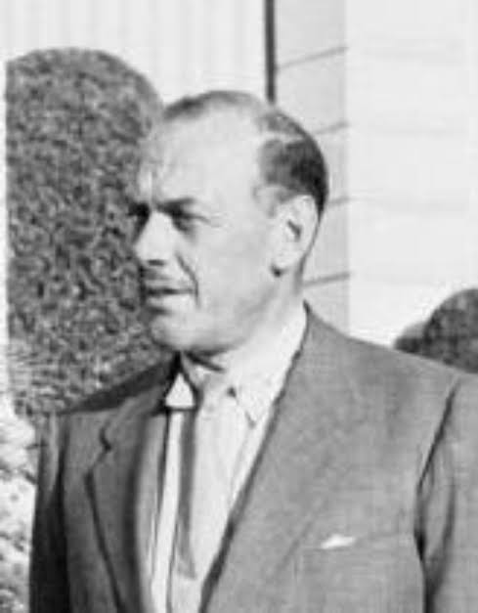
5) It introduced quasi-federalism i.e Regional houses were not given full powers.
6) Nigerian ministers were not given portfolios.
LYTTLETON CONSTITUTION
This constitution was named after the Governor General Lyttleton.
FEATURES
1) It had the structure of a federal system of government with constitutional division of powers.
2) Lieutenant-Governors in the regions became Governors and Governor became Governor
Sir Oliver Lyttleton

Slide 25
General.
3) It made provision for the post of a speaker of House of Representatives.
4) Lagos was detached from Western Region and made Federal Capital
5) It provided for a Federal Supreme Court.
6) Regional Houses of Assembly were given residual powers to pass bill into laws without the approval from the central government.
7) It created post of premiership of the regional councils.
ACHIEVEMENTS
1) Each region had its own civil service and judiciary
2) It gave birth to Federal system of government in Nigeria.

Slide 26
3) It established a Federal Capital Territory (Lagos).
4) It established a supreme court for Nigeria.
5) It created the post of a Premier as the head of government in the region.
6) It created the offices of a speaker and deputy speaker in the regions.
WEAKNESSES
1) No provision for the post of a Prime Minister as the head at the central level
2) No uniform electoral system in all the regions
3) The governor-general still had veto power.
4) Ministers were loyal to their regional leaders.
5) No provisions for bicameral legislature at the centre

Slide 27
YR 9: WK 3
TOPIC: PRE-INDEPENDENCE CONSTITUTION
>> Evaluation
Question 1
State three features of Macpherson Constitution.
Question 2
State any two features of Richard Constitution.
Question 3
Mention two features of Clifford Constitution
Question 4
Outline three merits and three demerits of Macpherson constitution
Question 5
State five features of Lyttleton constitution
Question 6
Explain the benefits of Lyttleton constitution

Slide 28
Any Questions?

Slide 29
YR 9: WK 3
At the end of this topic, students should be able to;
1) State the features of independence constitution of 1960
2) State the features of 1963 republican constitution
3) Describe the advantages and disadvantages of 1963 republican constitution
WEEK THREE TOPIC:
INDEPENDENCE CONSTITUTION OF 1960
Home page

Slide 30
INTRODUCTION
FEATURES OF INDEPENDENECE CONSTITUTION OF 1960
1) The Governor General was the ceremonial head of state
2) The prime minister was the head of government and administration
3) It provided for a democratic parliamentary system of government
4) Fundamental human rights were entrenched in the constitution
5) The constitution was a rigid constitution
6) It laid down procedure for region creation

Slide 31
ACHIEVEMENTS
1) It brought in independence for Nigeria
2) It made provision for human rights.
3) It defined citizenship and how it can be acquired.
4) It made provisions for fusion of powers
5) It stipulated procedure for appointment of supreme and High Courts Judges.
WEAKNESSES
1) It did not give total sovereignty to Nigeria as a nation.
2) The Queen was still the Head of State and this gave room for some interference.

Slide 32
3) The supreme courts had no power over appellate cases.
POST-INDEPENDENCE CONSTITUTIONS
These were constitutions made after Nigerian independence in 1960
The Republican Constitution of 1963
This was born out of all-party conference held in July, 1963 in Lagos. AT this conference it was decided that Nigeria should become a republic and so, important changes in the constitution became necessary.
Features of 1963 Republican Constitution
It made provision for the office of the Head of State who replaced

Slide 33
Queen as the Head of State.
2) It retained parliamentary system of government
3) The Prime Minister was the Head of Government.
4) It abolished the Judicial service commission.
5) It brought in republican form of government.
6) Supreme Court was made the highest Court of Appeal.
ACHIEVEMENTS
1) It gave Nigeria a republican form of government
2) An elected Head of State by the parliament replaced the Queen as the Queen as the Head of State.
3) It was the first constitution fully made by Nigerians.

Slide 34
4) It brought British political interference and influence in Nigeria to an end.
PROBLEMS
1) No supremacy of the constitution but supremacy of the parliament
2) No clear separation of powers
3) The Prime Minister was accountable to the parliament and to the people.

Slide 35
YR 9: WK 3
TOPIC: INDEPENDENCE CONSTITUTION OF 1960 >> Evaluation
Question 1
Stat three features of Independence Constitution of 1960
Question 2
State history achievement of Independence Constitution of 1960
Question 3
List three achievement of the republican constitution of 1963
Question 5
What are the problems of the republican constitution of 1963
Question 3
State atleast three post independence constitution

Slide 36
Any Questions?

Slide 37
YR 9: WK 4
At the end of this topic, students should be able to;
1) State the features of the 1979 constitution
2) State the achievements of the 1979 constitution
3) State the features of the 1989 Presidential Constitution.
4) Give reasons why the constitution is supreme
WEEK FOUR TOPIC:
THE PRESIDENTIAL CONSTITUTION OF 1979
Home page

Slide 38
INTRODUCTION
This came to life after the successful completion of Justice Udo Udoma-led constitution drafting committee in June, 1978.
FEATURES
1) It provided for the office of the executive president who was the head of state and commander-in chief of the Nigerian armed forces.
2) The President has maximum of two terms of four years each.
3) It provided for the office of the Vice President.
4) It maintained bi-cameral legislature at the centre and

Slide 39
Unicameral at the state level.
5) There was clear separation of powers.
6) The federal character was initiated
7) Provided for election at Local Government level.
ACHIEVEMENTS
1) It created the office of the Executive President who was popularly elected.
2) There was clear separation of powers
3) There was supremacy of the constitution
4) Provided for a new Federal Capital territory
5) Fully elaborated and guaranteed rights of individuals

Slide 40
PROBLEMS OF 1979 CONSTITUTION
1) It is very expensive to operate
2) Too much power at the centre
3) Introduction of impeachment clause was a problem
THE 1989 PRESIDENTIAL CONSTITUTION
The constitution was born out of the report of the constituent Assembly established by Babangida Administration in 11th May 1988.
FEATURES
1) It retained Presidential System of government
2) It introduced two-party system

Slide 41
3) Legislative houses were to be on part-time basis.
4) The minimum qualification for major political offices was school certificate
5) Fundamental human rights were entrenched.
6) Citizenship by birth, registration and naturalization were well defined.
7) It made provision for the independence of the Judiciary.
THE 1999 PRESIDENTIAL CONSTITUTION
FEATURES
1) It retained Presidential system of government.
2) It set minimum academic qualification for major political offices.

Slide 42
3) It provided for 36 states including the FCT, Abuja.
4) It retained the bi-cameral legislature at the centre
5) Provided for independence of the judiciary
6) It made provision for code of conduct Bureau, The Federal Character Commission etc.
7) It makes provision for a revenue allocation formula, exclusive and legislative lists.
SUPREMACY OF THE CONSTITUTION
Supremacy of the constitution simply means the constitution (law of the land) is above everybody. It follows therefore that the government, its agencies and individuals in the country must act according to the

Slide 43
provisions and dictates of the constitution.
Supremacy of the constitution means there is only one constitution for the country which is above anyone.
Supremacy of the constitution is one of the basic principles of the rule of law.
WHY THE CONSTITUTION IS SUPREME
1) The three arms of government derive their power from it.
2) It is the basis of all electoral activities.
3) It dictates the relationship among the three tiers of government
4) It is the final authority over any matter in the country
5) It is supreme to avoid any form of dictatorship in a nation

Slide 44
6) It is supreme for smooth running of government in a country
7) To protect the minority rights
8) To ensure political stability
ROLE OF CITIZENS IN CONSTITUTIONAL DEVELOPMENT
a) Voting to elect representatives at the National Assembly
b) Working in constitutional drafting committee
c) Sending memoranda to the National Assembly
d) Sending memoranda to Constitutional drafting committee
e) Speaking at public hearing
f) The citizens through civil society organizations, public affairs analysts and other well-meaning individuals could identify some weakness in the

Slide 45
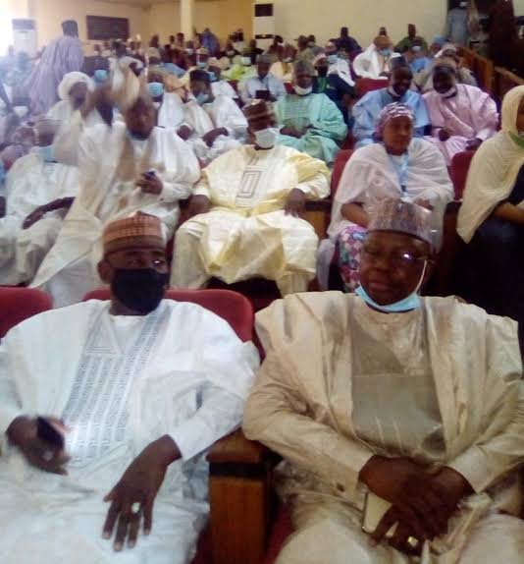
existing constitution and make suggestions to government on how to solve them.
g) The citizens also make their views known through the mass media such as radio, television and newspapers.
Participants at a Public Hearing on Constitutional Review

Slide 46
YR 9: WK4
TOPIC: : THE PRESIDENTIAL CONSTITUTION OF 1979 >> Evaluation
Question 1
Mention three features of 1979 Constitution
Question 2
State five features of 1999 constitution
Question 3
Explain the term Supremacy of Constitution
Question 4
Explain the process involved in Constitutional Development
Question 5
What are the roles of citizens in Constitutional development?
Question 6
What is the role of government in the Constitutional development of a country?

Slide 47
Any Questions?

Slide 48
YR 9: WK 5
At the end of this topic, students should be able to;
1) Explain the meaning of Right Attitude to work
2) State the attributes of Right Attitude to work
3) State the rewards of right attitude to work
4) Understand the wrong attitude to work and their consequences
5) Know how to promote the right attitude
WEEK FIVE TOPIC:
RIGHT ATTITUDE TO WORK
Home page

Slide 49
INTRODUCTION
MEANING: Attitude means the way an individual thinks and feels about someone or something. It also means a feeling or way of thinking that affects a person’s behaviour.
Work is a job or activity that you do regularly especially in order to earn money (income). Our attitude to work is the way and manner we attend to our duties. Good or right attitude to work results in success while bad or wrong attitude to work results in failure. Zig Zigler, an American Author and Motivational Speaker says- “Your attitude, not your aptitude will determine your attitude”. This statement means how far an individual will go in life depends on his or her attitude towards the activity he or she does regularly

Slide 50
ATTRIBUTES OF RIGHT ATTITUDE TO WORK
A) DISCIPLINE: Discipline is the training of the mind and body to produce obedience and self-control. According to jim Rohm, an American Author and Motivational Speaker, “discipline is the bridge between goals and accomplishment” It means that to be successful in life, an individual need to be disciplined.
B) PUNCTUALITY: Thomas C. Halliburton, a Canadian Judge and Motivational Speakers says – “Punctuality is the soul of business”. An individual with the right attitude to work is able to regulate his sleep pattern so that he will be punctual at work. He is able to perform his or her duties effectively without being forced to do it.

Slide 51
C) HONESTY: According to Miquel De Cervantes, a Spanish Novelist, Poet and Playwright – “Honesty is the best policy”. Honesty is the quality of telling the truth, being trustworthy, fair, honourable, genuine and loyal with integrity in the discharge of one’s duty.
D) INTEGRITY AND TRANSPARENCY: Integrity refers to the ability of an individual to adhere strictly to high moral principles and standards while transparency refers to a state of being plain and objective. A person with the right attitude to work is known to have a high level of integrity and transparency.
E) COMMITMENT AND DEDICATION: Commitment and Dedication

Slide 52
Involve devotion to a cause of action, assignment or work. An individual with the right attitude to work will give a lot of time and effort to a particular activity or purpose because he or she thinks it is important.
F) CONSISTENCY: Consistency is the quality of always behaving in the same way of having the same opinions or standard. An individual with the right attitude to work should not change from being a good worker. He or she should be faithful, loyal and discharge his or her duties well without changing.
G) LEISURE: Leisure or free time means time spent away from business, work and domestic chores. It is time that is spent doing what one

Slide 53
enjoys when one is not working or studying. A person with the right attitude to work knows the essence of making good use of one’s free time after the day’s work, weekends, public holidays and annual leave.
H) SELFLESS SERVICE: This means thinking more about the needs or happiness of other people than about your own. A person with the right attitude to work lives a life of selfless service to his organisation and nation. He is ever ready to carry out his official duties with all his heart.
I) DILIGENCE: A person with the right attitude to work is careful and thorough in carrying out his duties.

Slide 54
J) CIVILITY- A person with the right attitude to work has a polite behaviour. He has a pleasant disposition in carrying out any duty.
K) REGULARITY – A person with the right attitude to work should not be a truant. He should always be at his duty post. He should always seek for permission whenever he would not be at work. Being absent from work without permission is an unacceptable behaviour that has dire consequences.
IMPORTANCE/REWARD OF RIGHT ATTITUDE TO WORK
(I) PROGRESS – Right attitude to work promotes progress, peace and unity in the organization and society at large. When a person is

Slide 55
dedicated to his duties, there will be growth in his career as well as the organization where he works, thus leading to the peace and progress of the society.
ii) EFFICIENCY: Right attitude to work increases the efficiency of the workers as they are able to do things well without wasting time and money.
iii) HIGH PRODUCTIVITY: Right attitude to work leads to higher productivity. Productivity refers to the rate at which a worker, business or country produces goods and the amount produced compared with how much time, work and money is needed to produce them.
iv) RECOGNITION: Recognition refers to public praise and reward for somebody’s work or actions. Workers who exhibit the right attitude to

Slide 56
work constantly and consistently are usually recognized by their community or country.
v) PROMOTION: Right attitude to work brings promotion to the workers. Workers who render services to their organizations with all their heart by being punctual, regular and diligent can earn their promotion easily.
vi) CONFIDENCE: Right attitude to work makes other people to have confidence in the workers of the particular organisation.
vii) IMPROVED NATIONAL IMAGE: The service delivery of people with the right attitude to work impacts positively on the image of a country especially those public officials who interact with the international public.

Slide 57
METHODS OF PROMOTING THE RIGHT ATTITUDE TO WORK AMONG CITIZENS
1) Work environment, salaries and wages should be made attractive to workers. This will enable them to be more productive.
2) Laws should be made to punish those who exhibit negative attitude in the workplace
3) Employers of labour should do their best to encourage and motivate staff.
4) The government should pay more attention to the provision of food for her citizens. The food items should be available and affordable for every one especially the low income earners.
5) The government should provide loans for those wishing to set up

Slide 58
small businesses.
6) The government should do her best to make the harsh economic conditions bearable for her citizens.
7) Development projects that will impact positively on the lives of the citizens should be embarked upon by the government.
CONSEQUENCES OF NOT HAVING THE RIGHT ATTITUDE TO WORK
a) INDISCIPLINE: Indiscipline is a lack of control on the behaviour of a group of people in an organisation. Forms of indiscipline such as late coming, sleeping on duty, closing before the official time and many bad attitude will set in.

Slide 59
b) LACK OF MOTIVATION: One consequence of not having the right attitude to work is that the workers will lack the motivation to continue to work in the organisation. The workers will lose interest in doing the job and do it just anyhow.
c) NATIONAL DISASTER: A person who does not have the right attitude to work will be negligent and non-challant in his work and people’s live would be in danger.
d) CONFLICT AND CHAOS: There will be conflict in the organisation as the efficient workers might disagree with inefficient ones.
e) BAD IMAGE: The country will not be respected by other countries of the world due to citizens’ bad attitude to work.
g) EMBEZZLEMENT: Workers may embezzle the organisation’s funds

Slide 60

when there is no commitment and dedication.
h) DECREASE IN PRODUCTIVITY: Constant absenteeism at work reduces man-hour which leads to low productivity. This will also affect the national income and economic growth.
A Lady receiving hand shake for being efficient at work

Slide 61
YR 9: WK 5
TOPIC: RIGHT ATTITUDE TO WORK >> Evaluation
Question 1
Explain what you understand by Right Attitude to work
Question 2
List the attributes of Right Attitude to work and write on any four of them.
Question 3
State three rewards of right altitude to work
Question 4
State four importance of right attitude to work

Slide 62
Any Questions?

Slide 63
YR 9: WK 6
At the end of this topic, students should be able to;
1) Explain the meaning of Negative Behaviour
2) State the types of Negative Behaviour such as drug trafficking/abuse, cultism, disregard for time, ostentatious living etc
3) Explain the effects of Negative Behaviour
4) State sanctions and strategies for promoting positive behavioural change
WEEK SIX TOPIC:
NEGATIVE BEHAVIOUR
Home page

Slide 64
INTRODUCTION
MEANING: The word ‘negative’ simply means bad or harmful, while ‘behaviour’ refers to the way that somebody behaves especially towards other people. Negative behaviour causes harm to individuals, groups and the society. Cheating, lying, stealing, truancy, drug addiction and trafficking are examples of negative behaviour. Negative behaviour is undesirable, unpleasant and unacceptable in the society.
People who indulge in these anti-social behaviours bring shame to themselves, their families and the country. Therefore, a good citizen is enjoined not to imbibe negative behaviour.

Slide 65
TYPES OF NEGATIVE BEHAVIOUR
a) DISHONESTY: Dishonesty is an act of telling lies and deceiving people. Dishonest people are not faithful and straightforward in words and actions. They cheat, steal and lie.
b) EXAMINATION MALPRACTICES: Examination malpractice is a negative behaviour exhibited by lazy students and examiners to ensure that undeserved students pass their examinations at all costs.
c) EXCESSIVE LOVE FOR MONEY: Money is good, without money we cannot live good lives. Money is used to provide the basic things of life like food, shelter, clothing, health and education. However, the excessive love of money is negative behaviour. This behaviour has led many people to commit murder in order to prepare money rituals for

Slide 66
them, traffic in hard drugs, embezzle public funds or commit fraud.
d) OSTENTATIOUS LIVING: There is no harm in being rich if legitimately acquired and used to assist the less privileged people in the society. However, when it comes to unnecessary show of wealth, flaunting material wealth like buying expensive cars, mansions, throwing expensive parties, they are wasteful.
e) DISREGARD FOR TIME (AFRICAN TIME MENTALITY): African time mentality is a negative behaviour borne out of indiscipline. Lack of time management gave rise to African time mentality which is the act of not getting to a function at the right time. It is an act of irresponsibility to keep guest and others waiting when you are supposed to chair an occasion .

Slide 67
f) DRUG TRAFFICKING: Drug trafficking is an illegal peddling or movement of dangerous drugs or substances prohibited by government through dubious means especially across national borders. Such drugs include cocaine, heroin and Indian hemp.
g) HUMAN TRAFFICKING: This is an illegal transportation, harbouring and sale of human beings into forced labour, prostitution and servitude. This illegal buying and selling of human beings is done through deceit, coercive and manipulative tactics. The National Agency for Prohibition or Traffic in Persons and other Related Offences (NAPTIP) is taking care of this societal menace.
h) PROSTITUTION: A prostitute is a person who has sexual intercourse in return for money. It is a dangerous and shameful act that exposes those

Slide 68
involved to deadly diseases, sexually transmitted disease (STD) as well as death, because there had been reported cases of prostitutes being used for money rituals.
EFFECTS OF NEGATIVE BEHAVIOUR ON THE SOCIETY
Negative behaviour among citizens has very bad effects on the society. Some of the ehffects include the following;
a) inefficiency: This refers to someone not doing a job or task well and not making the best use of time, money, skills and energy. This negative behaviour of having a non-chalant attitude to one’s duties, absenteeism or irregular attendance results in the retardation of both organisational and national development.

Slide 69
b) High Rate of Mental Disorder: Those who engage in drug trafficking most times, are drug addicts themselves. Continous use of pyschotic substances such as heroin, cocaine and Indian hemp may and could result in mental disorder.
c) High Crime Rate: Cultism increases crime rates as is being witnessed in some part of Lagos. Almost every day, rival cult groups engage in supremacy battles leading to deaths because of the use of firearms in their possession.
d) Unruly Behaviour/Lack of Respect: People with unruly behaviour will not obey rules and regulations. Youths that are deeply involved in Cultism, Alcoholism and Hard Drugs will not mind abusing their teachers, lecturers, parents, elders and colleagues.

Slide 70
e) Bribery and Corruption: The society will become corrupt and the people’s value will be misplaced. The excessive love of money and ostentatious living will encourage people to engage in bribery and corruption.
f) Bad Leadership: Corruption, embezzlement of funds, dishonesty will leads to bad leadership. Corrupt dishonest leaders will not think of the citizens but what they can illegally accumulate for themselves during their tenure.
g) Lack of Progress: Productivity will be much lower than it should be. The society will not progress and will eventually become backward.

Slide 71
STRATEGIES FOR PROMOTING POSTIVE BEHAVIOURAL CHANGES
1) Proper parenting: Parents having time with their children
2) Moral instructions: Moral instruction in schools and colleges
3) Mass media: The media plays an important role in nation building. Programmes, plays, articles, documentaries and opinions can be used to promote value orientation.
4) RELIGIOUS EDUCATION (FEAR OF GOD): “The fear of God is beginning of wisdom.” Religious leaders must guide their congregation positively.
5) GOOD LEADERSHIP: People in authority should lead by example. They should be role models for the young ones.
6) REWARD: People who behave well, display honesty, faithfulness and loyalty to the society or nation should be rewarded accordingly so that

Slide 72
it would encourage others to do same.
7) Punishment for the offenders: Those who put up negative behaviours should be properly dealt with by the law. There should be no sentiments. This will act as a deterrents to others.
SANCTIONS: In any society, sanctions are usually placed on negative behaviour. Punishable offences are either civil or criminal and so the nature of offence determines the type of punishment to be imposed. There are fines, imprisonment and death. The degree of punishment depends on the magnitude of the offence committed.

Slide 73
YR 9: WK 6t
TOPIC: NEGATIVE BEHAVIOUR >> Evaluation
Question 1
Explain the term negative behaviour
Question 2
State four of negative behaviours
Question 3
List four effects of negative behaviours.
Question 4
State five ways of promoting positive behaviour in the society.

Slide 74
Any Questions?

Slide 75
YR 9: WK 8
At the end of this topic, students should be able to;
1) Define Crime
2) Mention at least five common crimes
3) State the punishment for committing common crimes
WEEK EIGHT TOPIC:
SECURITY EDUCATION, COMMON CRIMES CAUSES AND EFFECTS
Home page

Slide 76
INTRODUCTION
MEANING:
Crimes are offences committed against individuals, group of people or society in general. They are serious negative behaviours which disturb the peace of people living in a community. Crimes are always a breach of the law of the land.
COMMON CRIMES:
The following are some of the crimes most often committed in the society and they punishment they attract:
1) Theft: This is the act of stealing another person’s property. It has to do with taking another person’s property

Slide 77
without his/her permission.
Punishment for theft: The major punishment for theft by law is imprisonment. The number of months or years to be spent in prison depends on what is stolen and the mode of stealing. The judge will have to determine this.
2) Rape: Rape is an act of having forceful sexual interaction with another person particularly a female gender. The female gender most often fall victim of rape by the male. But in few cases, a man can also be raped by a woman. Rape is a very serious crime. It often leaves the victim with bruises and serious wounds. Sometimes, the victim dies while being raped or later after the crime is committed.

Slide 78


Punishment for rape: The punishment for rape is imprisonment. The judge also determine the duration of imprisonment based on the seriousness of the crime.
Picture of raped victims

Slide 79
3) Drug trafficking: Drug trafficking means illegal act of carrying hard drugs such as heroin, cocaine and many others within or outside the country.
Punishment: The punishment for drug trafficking in Nigeria is 10 years imprisonment. In some countries too, the punishment is death.
4) Human Trafficking: This is an illegal act of transferring persons from one place to the other for exploitation purposes. It is a crime agianst humanity. The act is carried out through the use of force, abduction, deception, abuse of power etc. Human trafficking is done for many reasons among which are sexual exploitation, forced labour, slavery and other reasons.
Punishment: The punishment for human trafficking is 5-10 years

Slide 80
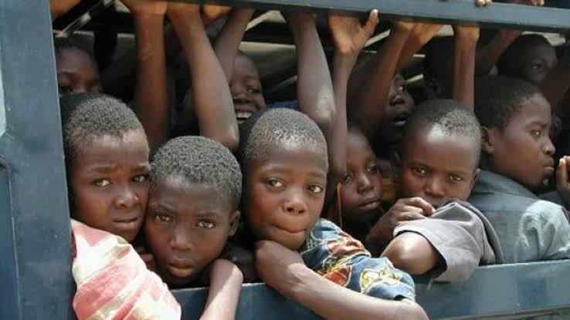
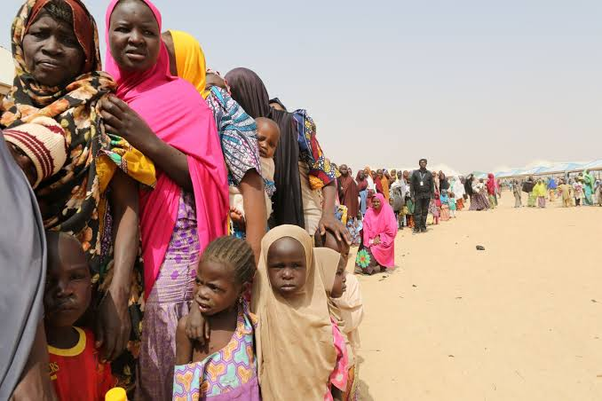
imprisonment depending on the gravity of the offence.
Victims of human trafficking
5) Murder: This is the act of taking another person’s life. It is the act of killing another person by using hand, gun, stone or any other materials or methods.

Slide 81
Punishment: The punishment for murder is death. The death penalty could be by hanging.
6) Domestic violence: According to Wikipedia – Free Encylopedia- Domestic violence is a pattern of behaviour which involves violence or other abuse by one person against another in a domestic setting. Domestic violence also refers to the physical abuse of a spouse or intimate partner. The major aim of domestic violence is to gain total control of the abused. It affects men, women and children but most often women are victims.
FORMS OF DOMESTIC VIOLENCE
Domestic violence can be in the following forms:
i) Economic form: This involves someone controlling you on how you

Slide 82
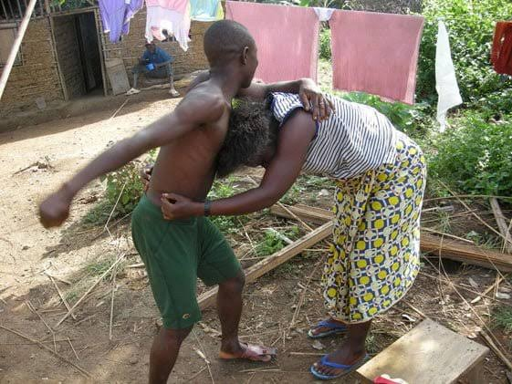
Should spend your personally earned income.
ii) Social Form: This involves teasing, insulting and embarrassing you in front of other people.
iii) Spiritual: This involves someone hindering you from having personal opinion, ideas about cultural and religious beliefs and values.
iv) Physical Form: This involves threatening to hurt, or actually hurting someone. It includes kicking, slapping, rape, beating etc.
v) Emotional form: This involve psychological torture.
A man beating his wife

Slide 83
PUNISHMENT: Section 36 of Nigerian criminal code impose a 2 year imprisonment for unlawful and indecent assault of a woman or girl while Section 353 of the code also imposes a 3-year imprisonment on unlawful and indecent assault of a male person. There is also a 10 year jail term for rape.
Drug Adulteration: Drug adulteration has been described as the practice of substituting original drug partially or wholly with other similar looking substances. It can be defined as the intentional mixing of inferior and harmful quality of a substance or chemical with drugs meant for sale. It renders the drugs impure, harmful and injurious for human consumption.

Slide 84
TYPES OF DRUG ADULTERATION
1) Substitution by commercial varieties.
2) Substitution with inferior drugs
3) Substitution with artificially manufactured substances
4) Substitution with exhausted drugs
5) Substitution with synthetic materials
6) Substitution with harmful adulterants
EFFECTS OF DRUG ADULTERATION
1) It creates further health problems in the body
2) May lead to death of innocent consumers.
Punishment: It is determined by the Court based on the gravity of the offence.

Slide 85
YR 9: WK 8
TOPIC: SECURITY EDUCATION, COMMON CRIMES CAUSES AND EFFECTS >> Evaluation
Question 1
What do you understand by Crime?
Question 2
Mention at least five common crimes in Nigeria.
Question 3
State the punishment for common crimes in Nigeria
Question 4
What is drug adulteration?
Question 5
State two effect of drug adultration.

Slide 86
Any Questions?

Slide 87
YR 9: WK 9
At the end of this topic, students should be able to;
1) Define meaning of crime?
2) Identify common crimes
3) State the causes of common crimes
4) Mention effect of common crimes
5) Report appropriate ways of relating with security agents
6) Learn how to avoid criminal behaviour s
WEEK NINE TOPIC:
NATIONAL SECURITY
Home page

Slide 88
INTRODUCTION
CRIME
A crime can be defined as any act of offence that results in harm to society and which is punishable by the state. A person who commits crimes has violated the law of the land and he is liable to punishment. It can also be define as an illegal or immoral activities. It is an action or omission which constitutes an offences and its punishable by law.
COMMON CRIMES
Common crimes are offences under the common law. This include theft, rape, falsehood etc.
EXAMPLES OF COMMON CRIMES
1) Falsehood: A falsehood is a statement that distorts or

Slide 89
suppresses the truth, in order to deceive.
2) Theft: A criminal act in which property belonging to another is taken without that person’s consent.
3) Rape: rape is a type of sexual assault usually involving sexual intercourse or other forms of sexual penetration perpetrated against a person without that person’s consent.
4) Murder: Murder is the unlawful premeditated killing of one human being by another.
5) Advance free fraud (419): Wrongful or criminal deception intended to result in financial or personal gain.
6) Dealing in fake drugs

Slide 90
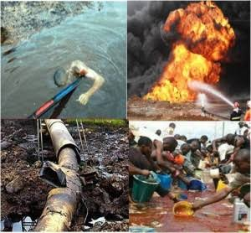

7) Sales of contaminated food
8) Drug abuse
9) Robbery
10) Vandalism
Incident of drug abuse
Vandalisation of pipe lines by criminals

Slide 91
CAUSES OF COMMON CRIMES
1) Poverty: This is sometimes the lame excuse of criminals. Poverty can at some point be one factor that can trigger criminals to commit a crime but the society should also be blamed for this because criminals are tempted to get the material things that they see around while other offenders really need money and food so they resorted to theft or robbery.
2) Parental Neglect: Statistics has proven that many offenders particularly young people lack supervision by parents. Some are fatherless or motherless while others are abandoned by their parents or in the care of a relative who care less in they way they should be brought up.

Slide 92
3) Influence of Media and Environment: The movies and shows we see on television, watch on youtube and video or easily access on the internet can truly influence on they way people thinks. Young people who have seen violent movies or brutal acts on Television may think that being violent is acceptable.
4) Lack of love: Studies show that many offenders are those that feel neglected by their friends/families. They felt unloved by their parents or siblings thus they attempt to be accepted by the outside world. Some of them unfortunately meet bad people and join gangs.
5) Drug and alcohol abuse: When someone needs money to buy drugs in which they are now addicted to. They resort to stealing money just

Slide 93
to buy drugs they want. Crimes are also committed because those who are drug addicts or under the influence of alcohol can no longer think clearly and cannot distinguish bad from good thus they commit murder or other crimes.
6) Lack of proper education and judgement: Some people who lack education commit a crime because they are not taught by teachers the proper manners and good values that they should have. They tend to have poor judgement and cannot distinguish right from wrong because they are not properly guided in school.
7) Greed: This is another cause of common crime in the society. Greed drives some people to engage in crime. Selfishness and self-

Slide 94
centered makes some people involve in one criminal activity to another.
8) Unemployment: The high rate of unemployment among the youth is major cause of crimes. Some people who do not have jobs see crime as a job in order to survive.
EFFECTS OF COMMON CRIMES
A) VIOLATION OF LAW: Violation of laws as a result of being under the influence of alcohol or drug is one effect. Criminal behaviours resulting from the effect of alcohol or drug include fights, thefts, violence against friends and family.

Slide 95
B) AFFECT NATIONAL DEVELOPMENT: Crime has damaging effect on national development. Crime is an obstacle to country’s rapid growth and development. Crime has become the most significant challenge to economic development of any country.
C) AFFECT PEACE AND HARMONY: All kinds of crimes such as murder, armed robbery, kidnapping, corruption and others affect peace and harmony of society. Crimes cause insecurity and make people live in fear.
D) LEAD TO DEATH OF PEOPLE: Crimes lead to death of number of people in the society yearly. Crimes lead to death of people directly or indirectly. For instance, violent crimes such as armed robbery,

Slide 96
terrorist attack and ritual killing result to direct death of the victims.
E) DESTRUCTION OF PROPERTY: Destruction of properties is another effect of crime in the society. Among the crimes which lead to destruction of property in the society include vandalism, juvenile offences and other violent crimes.
F) MIGRATION: Crime is one of the factors that may lead to both internal migration as well as international migration. This caused the fact that most people prefer to settle in areas where they are sure of security for themselves. People migrate from those areas where crimes are high to areas where there is no crime or areas where violent crimes are low.

Slide 97
G) EROSION OF MORALITY IN THE SOCIETY: Crimes by themselves are immoral and against social norms and customs. A good example of these kinds of crime includes prostitution, rape and drug abuse. These kinds of crime are immoral in their nature and increase the erosion of morality in the society.
H) INSECURITY: In the situation where the society lacks confidence, criminal acts endanger the lives and safety of the public in general.
CRIME PREVENTION
Crime prevention is the attempt to reduce and deter crimes and criminals. There are many ways you can take to prevent crime in your home, in your neighbourhood, and at your schools.

Slide 98
Some of the ways are discussed below:
A) BUILD: Build a partnership with police. Focus on solving problems instead of reacting to crises. It is important to build a partnership with the police to make it possible for people to report suspicious activity or crimes without fear of retaliation.
B) ENFORCE LAW: This is to work out with local security officials to use new ways to get criminals out of community or neighbourhood. These include enforcing local or community laws to prevent crimes.
C) EDUCATION: Education is an essential element in reducing the crime rate in the long run. The more widespread the education is, the less crimes are committed in a society. The government should always guarantee the need to empower and educate its citizens in all areas

Slide 99
they will help them to be self-reliant.
D) MEDIA COVERAGE: This is another way to prevent crime. The media report about a particular crime enlightens the public and creates awareness to prevent such crime in another area. For instance, the media report on Boko Haram has really helped other people in other areas not prone to terrorist attack to be vigilant and alert against such attack.
E) REDUCE UNEMPLOYMENT: Unemployment problem must be tackled by both government and stakeholders to reduce crimes in the society. Government should create enough jobs for the youths and jobless individuals and make them engage in one activity to the other.

Slide 100
F) REORDER SOCIETAL VALUES: The reordering of our societal values are not present based on the excessive desire for material wealth is vital to prevent crimes in our society.
G) REDUCE POVERTY: To prevent crime, government needs to eliminate poverty and create equal access to the country’s resources by everyone.
H) HOME TRAINING: The home is a pivotal point in the prevention of crimes. Homes where training and family ties are weak and religious influences are lacking are forces to criminal behaviours. Motivation for decent behaviours must be nurtured in the home. Parents should not only teach a child to walk and talk but also teach them how to trust in their strenght without resorting to crime to achieve goals.

Slide 101
YR 9: WK 9
TOPIC: NATIONAL SECURITY-COMMON CRIME>> Evaluation
Question 1
What is a crime?
Question 2
Identify five common crime in your environment
Question 3
State five causes of common crime
Question 4
Mention five effect of common crime
Question 5
Mention five ways to avoid criminal behaviours in the society

Slide 102
Any Questions?

